Slide 1
Digital Portfolio
STUDENT NAME: R.Gracy Priya
REGISTER NO AND NMID: asbru001224bcs103
DEPARTMENT: bsc computer science
COollege :Government Arts and science College in Coimbatore

Slide 2
PROJECT TITLE Digital Portfolio Platform for Students and Professionals

Slide 3


AGENDA
Problem Statement
Project Overview
End Users
Tools and Technologies
Portfolio design and Layout
Features and Functionality
Results and Screenshots
Conclusion
Github Link
3/21/2024 Annual Review

Slide 4

PROBLEM STATEMENT
Traditional resumes alone are insufficient to showcase skills and projects effectively in today’s digital era.
Many students and professionals lack a structured online presence to highlight their work.
There is a need for an interactive and accessible platform to present achievements, skills, and experiences.
A digital portfolio serves as a dynamic tool for showcasing personal and professional growth.
Such portfolios provide a comprehensive, multimedia representation of abilities beyond static documents.

Slide 5

PROJECT OVERVIEW
Creating and managing personalized portfolios with sections for skills, projects, and accomplishments.
Providing an interactive interface for users to update and highlight their evolving expertise.
Enabling easy sharing of portfolios with potential employers, collaborators, or educational institutions.
Supporting multimedia content such as images, videos, documents, and links.
Offering accessibility on various devices to ensure users can present their work anytime, anywhere.

Slide 6

WHO ARE THE END USERS?
Students: Who need an effective way to showcase their academic projects, skills, and achievements for internships, admissions, or job opportunities.
Professionals: Including job seekers and working individuals who want to present their work experience, skills, certifications, and projects in a structured and interactive manner.
Educators and Mentors: Who may use the platform to review and assess the progress and accomplishments of their students or mentees.
Employers and Recruiters: Who can use the platform to evaluate candidates based on comprehensive portfolios rather than just traditional resumes.

Slide 7

TOOLS AND TECHNIQUES
HTML: To structure the web pages and content of the digital portfolio, including sections for skills, projects, and achievements.
CSS: To style the web pages, ensuring a visually appealing, responsive, and user-friendly interface.
JavaScript: To create interactive elements on the front end, such as dynamic content updates, form validation, and user interface enhancements.
SQL: To manage the backend database, storing user data, portfolios, projects, skills, and other relevant information securely and efficiently.

Slide 8
POTFOLIO DESIGN AND LAYOUT
Clear Cover Page: Start with your name, title, and a professional photo to make a strong first impression.
Organized Sections: Divide your portfolio into About Me, Skills, Projects, Achievements, Education, and Contact details for easy navigation.
Visual Appeal: Use consistent fonts, colors, and spacing with quality images or icons to enhance readability.
Project Highlights: Showcase each project with a title, description, technologies used, and visual examples or screenshots.
Simple & Clean Layout: Maintain plenty of white space, avoid clutter, and keep each slide focused on one topic or achievement.
8

Slide 9
FEATURES AND FUNCTIONALITY
User-Friendly Interface: Easy navigation with clean layouts and clear sections for quick access to your information.
Responsive Design: Adapts seamlessly across devices and screen sizes to maintain consistent viewing experience.
Dynamic Content Management: Allows adding/removing projects and achievements with images and descriptions in real-time.
Data Persistence: Saves all entered data locally (using browser storage) to prevent loss and enable editing anytime.
Export Capability: Enables exporting the complete portfolio as a PDF document directly from the interface.

Slide 10
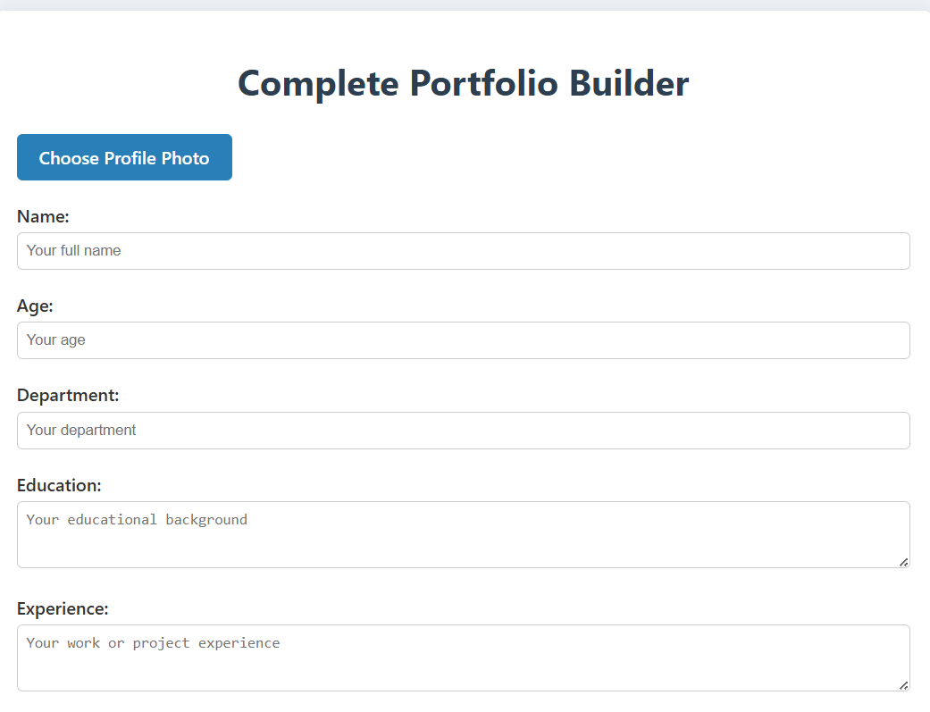
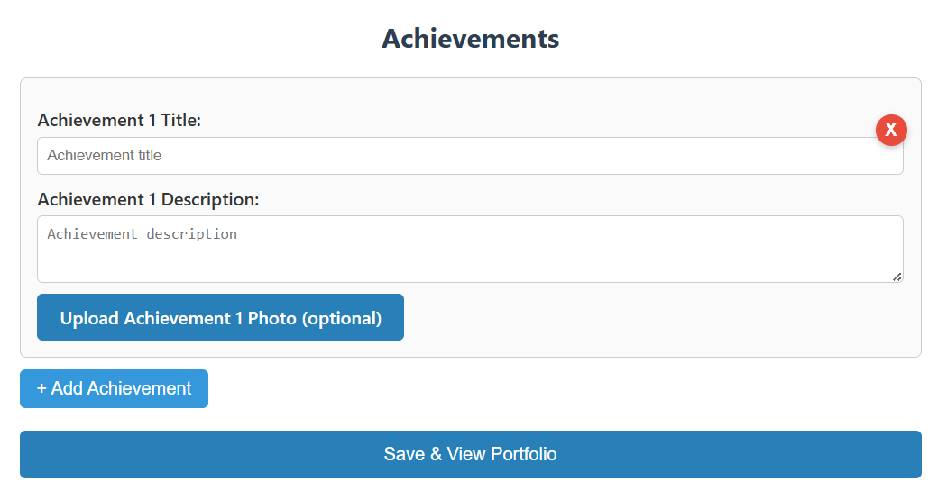
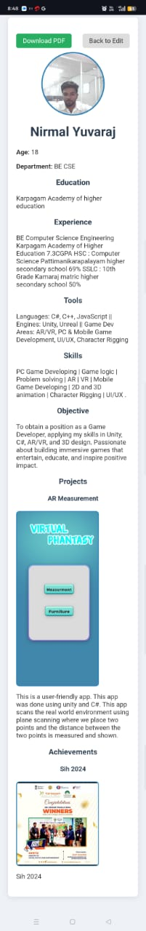
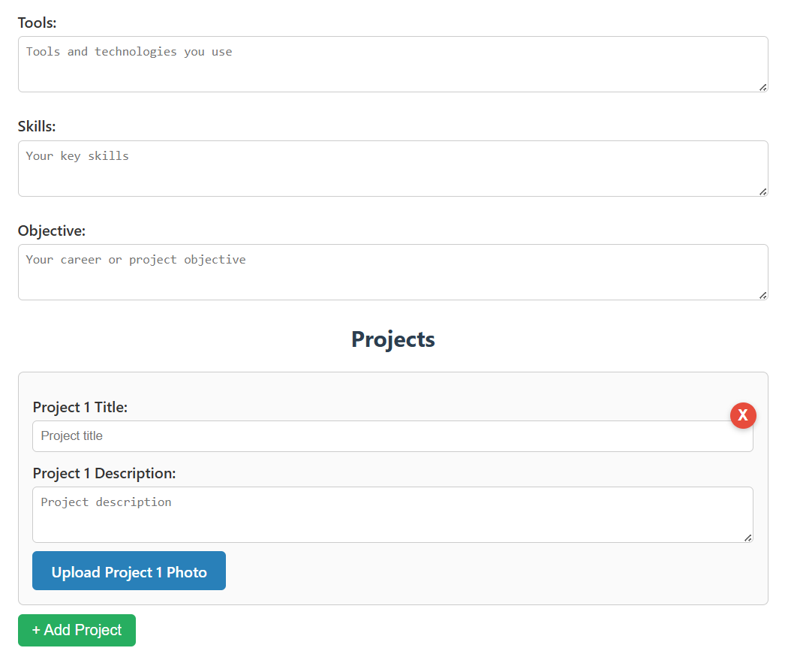
RESULTS AND SCREENSHOTS
10

Slide 11
CONCLUSION
Clean and Organized Structure: Use clear, simple layouts with sections like About Me, Skills, Projects, and Achievements for easy navigation.
Consistent Visual Style: Apply uniform fonts, colors, and spacing to create a professional and cohesive look.
Engaging Visuals: Incorporate high-quality images and icons relevant to projects and skills to make the portfolio visually appealing.
Effective Content Hierarchy: Prioritize important information with clear headings, bullet points, and strategic use of whitespace.
Responsiveness and Flexibility: Design layouts that adapt well to different formats (print, digital) and allow easy updates or it
GitHub link
https://github.com/gracypriyaaa/Digital-portfolio.git
11

